Slide 1





GLA UNIVERSITY
Computer Network

Slide 2

Switching

Slide 3
Switch
A switch is a device in a computer network that connects
other devices together
Multiple data cables are plugged into a switch to enable communication between different networked devices
A switch is a device that is used at the Access or OSI Layer 2
We use switches in circuit-switched and packet-switched networks

Slide 4
Switching Technique
How 2 devices communicate when there are many devices?
  One alternative is to establish point to point connection between each pair of devices using mesh topology (which is highly complex)
  The other alternative is to use switching techniques leading to switched
connection network

Slide 5
Switching Technique
There are three typical switching techniques available for digital
traffic
  Circuit Switching
  Message Switching
  Packet Switching

Slide 6
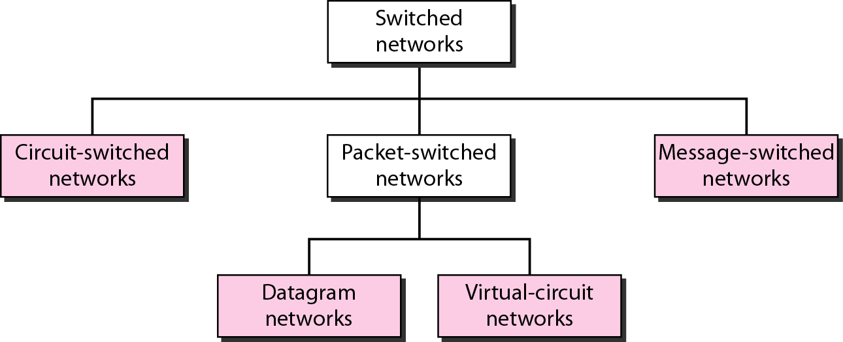
Classification of switched networks

Slide 7
Circuit-switched networks
A circuit-switched network consists of a set of switches connected
by physical links
A connection between two stations is a dedicated path made of one or more links
Each link is normally divided into n channels by using FDM or TDM
Routing decisions must be made when the circuit is first established, but there are no decisions made after that time

Slide 8
Circuit Switching
There are three phases in circuit switching:
  Establish ( Connection Establishment)
  Transfer (Data Transfer)
  Disconnect ( Connection Release or Tear Down)
The message arrives in the same order that it was originally sent

Slide 9
Circuit Switching
Advantages:
The communication channel (once established) is dedicated
Disadvantages:
Possible long wait to establish a connection
More expensive than any other switching techniques
Inefficient use of the communication channel

Slide 10
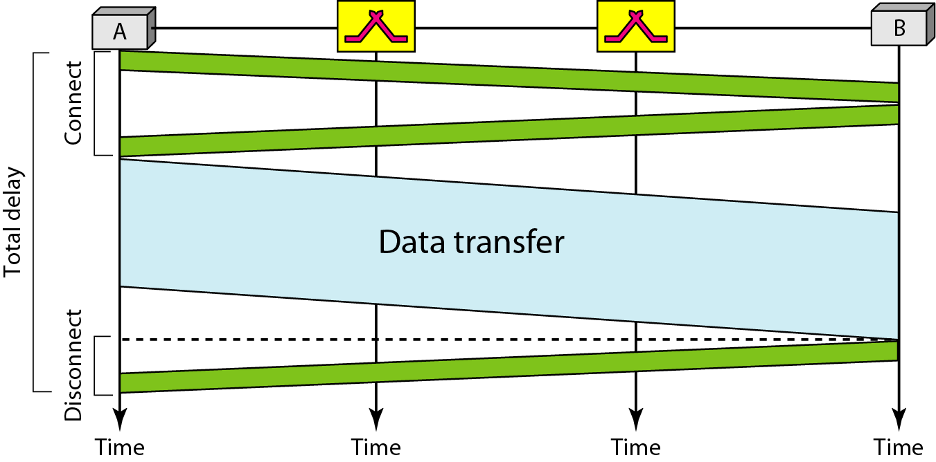
Delay in a circuit-switched network
Total Delay in a circuit-switched network will be delay for
– setup and tear down + Propagation delay + Transmission delay
Total Delay = 3 * Propagation time + 3 * Transmission time + Data Transfer time

Slide 11
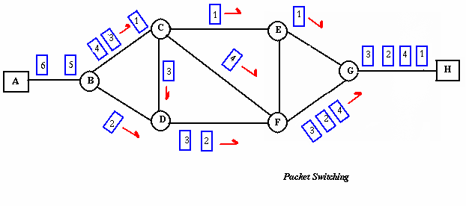
Packet Switching
In packet switching, the message gets broken into small data packets
These packets travel around the network seeking out the most efficient route to reach to destination
This does not necessarily mean the shortest route
Each packet may follow a different route
There are two methods:
  Datagram AND
  virtual circuit packet switching

Slide 12
Packet Switching
Advantages
  Delay in delivery of packets is less
  Switching devices don’t require massive storage
  Data delivery can continue even if some parts of the network fails
  It allows simultaneous usage of the same channel by multiple users
  It ensures better bandwidth usage

Slide 13
Packet Switching
Disadvantages
  High installation costs
  They require complex protocols for delivery
  Network problems may delay in delivery of packets or loss of packets

Slide 14
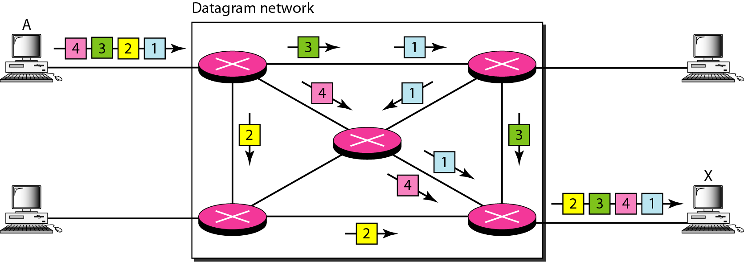
Packet Switching
In datagram approach, the message is divided into small packets of
fixed or variable size
The size of the packet is determined by the network and the governing protocol

Slide 15
Packet Switching
In a packet-switched network, there is no resource reservation;
resources are allocated on demand
A switch in a datagram network uses a routing table that is based on the destination address
The destination address in the header of a packet in a datagram network remains the same during the entire journey of the packet

Slide 16
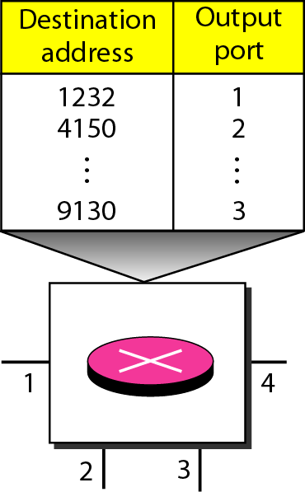
Routing table

Slide 17
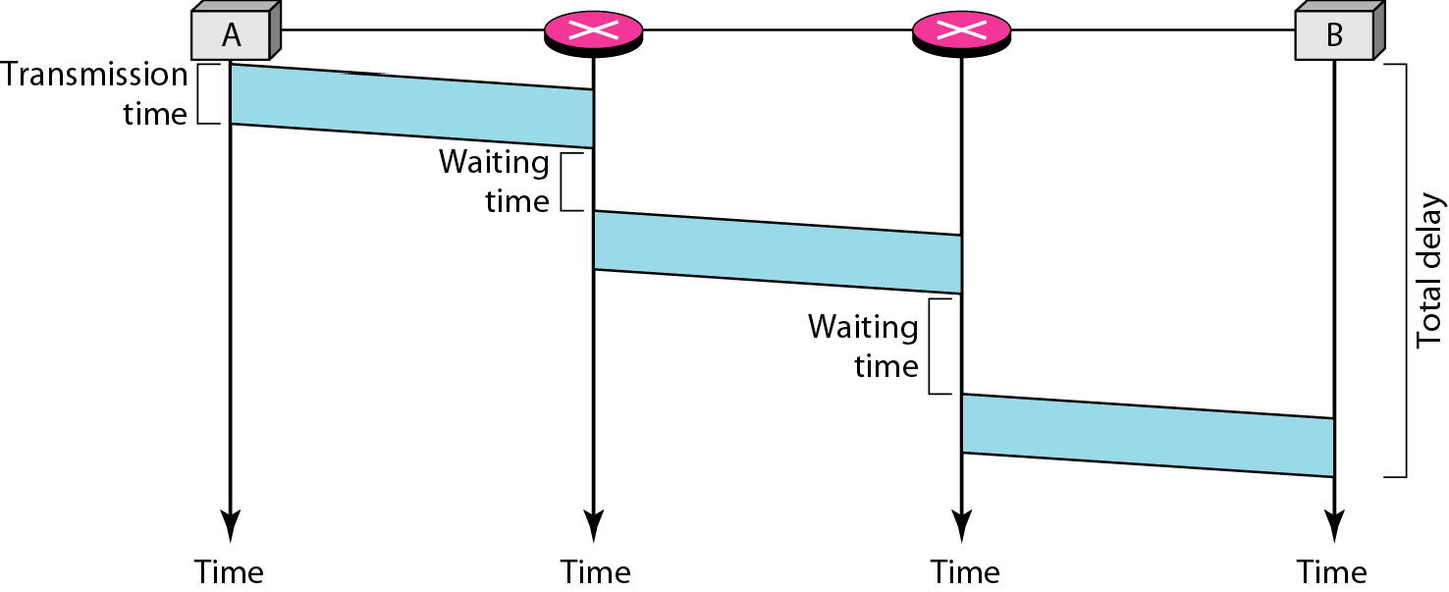
Delay in network

Slide 18
Datagram switching
Eg:
Datagram | Path Length | Visited Switches
1 | 3200 km | 1,3,5
2 | 11,700 km | 1,2,5
3 | 12,200 km | 1,2,3,5
4 | 10,200 km | 1,4,5
5 | 10,700 Km | 1,4,3,5
– We assume that the delay for each switch (including waiting and processing) is 3,10, 20, 7, and 20 ms respectively. Assuming that the propagation speed is 2 x 10⁸ m, find the order of arrival at the destination and the delay for each. Ignore any other delays in transmision.

Slide 19
Datagram switching
Solution

Slide 20
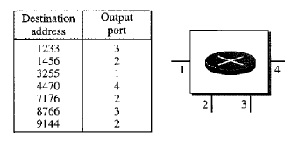
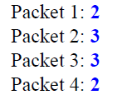
Datagram switching
Eg:
  Figure shows the switch in a datagram network. Find the output port for packets with the following destination address.
  Packet 1: 7176
  Packet 2: 1233
  Packet 3: 8766
  Packet 4: 9144

Slide 21
Virtual circuit switched networks
A virtual-circuit network is a mixture of circuit switched network
and a datagram network
Virtual-Circuit network guarantees that
  the packets sent arrive in the order sent
  with no duplicates or omissions
  with no errors (with high probability)
  regardless of how they are implemented internally

Slide 22
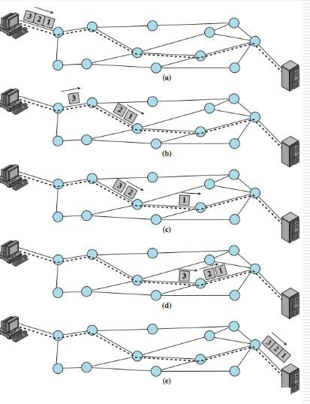
Virtual circuit switched networks

Slide 23
Virtual circuit switched networks
How it is implemented ?
  Addressing:
    In a virtual-circuit network, two types of addressing are involved: global and local (virtual-circuit identifier)
  Global Addressing:
    A source or a destination IP address is considered to be global address
  Virtual-Circuit Identifier:
    The identifier that is actually used for data transfer is called the virtual-circuit
identifier (VCI)
    A VCI is a small number that has only switch scope
    It is used by a frame between two switches
    When a frame arrives at a switch, it has a VCI; when it leaves, it has a different VCI

Slide 24
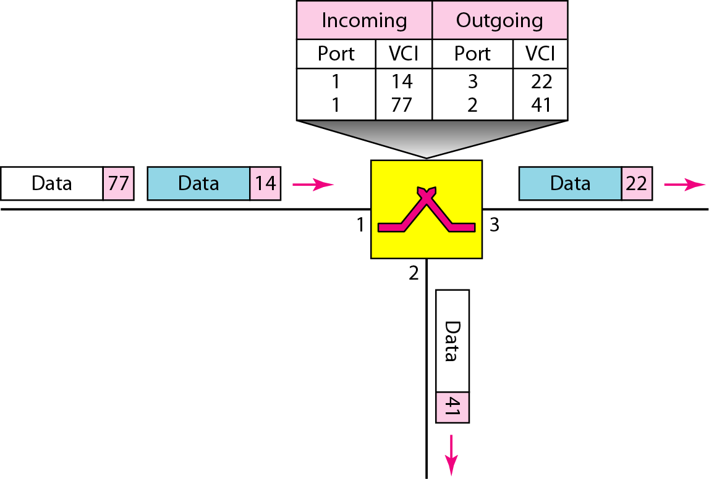
Switch and tables in a virtual-circuit network

Slide 25
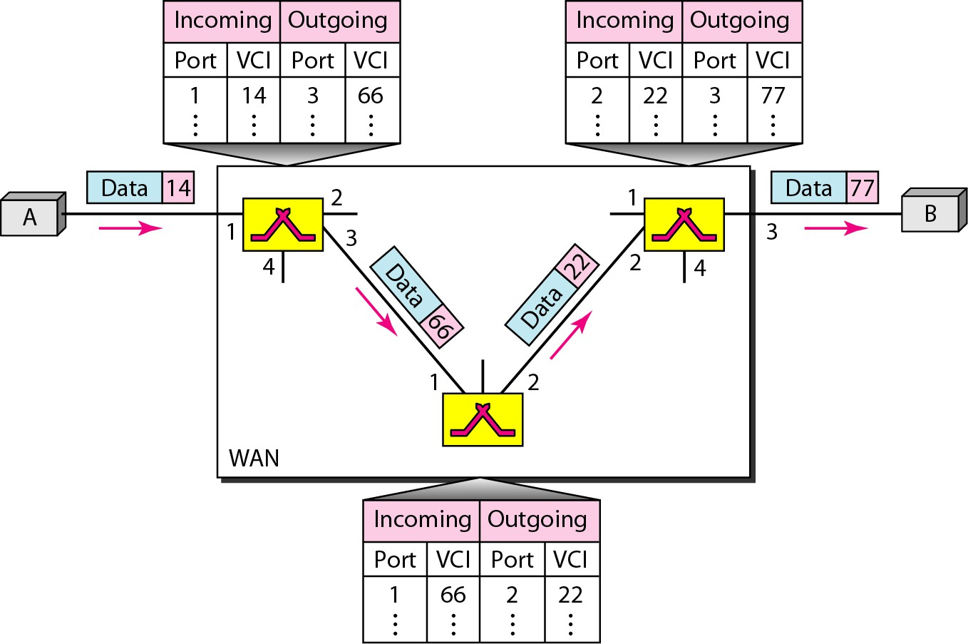
Data transfer in a virtual-circuit network

Slide 26
Virtual circuit switched networks
How Virtual Circuit is Established ?
A source and destination need to go through three phases:
  Setup phase:
    the source and destination use their global addresses to help switches
make table entries for the connection
  Data transfer
  Teardown phase:
    the source and destination inform the switches to delete the corresponding entry

Slide 27
Virtual circuit switched networks
Setup Phase:
  Suppose source A needs to create a virtual circuit to B.
  Two steps are required:
    the setup request
      A setup request frame is sent from the source to the destination
    the acknowledgment
      A special frame, called the acknowledgment frame, completes the entries in the
switching tables

Slide 28
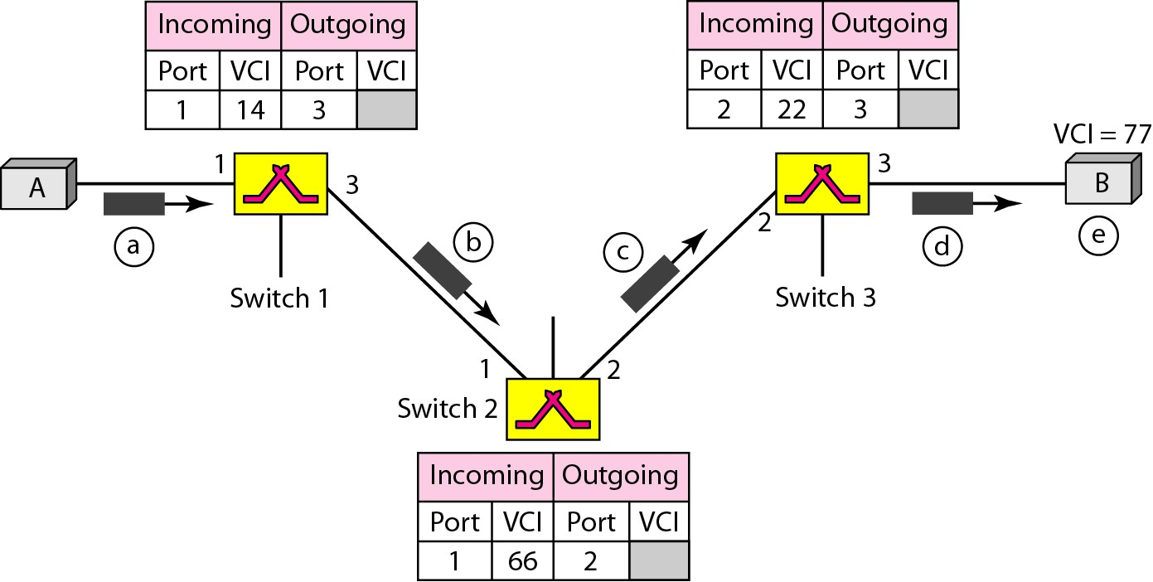
Virtual circuit switched networks

Slide 29
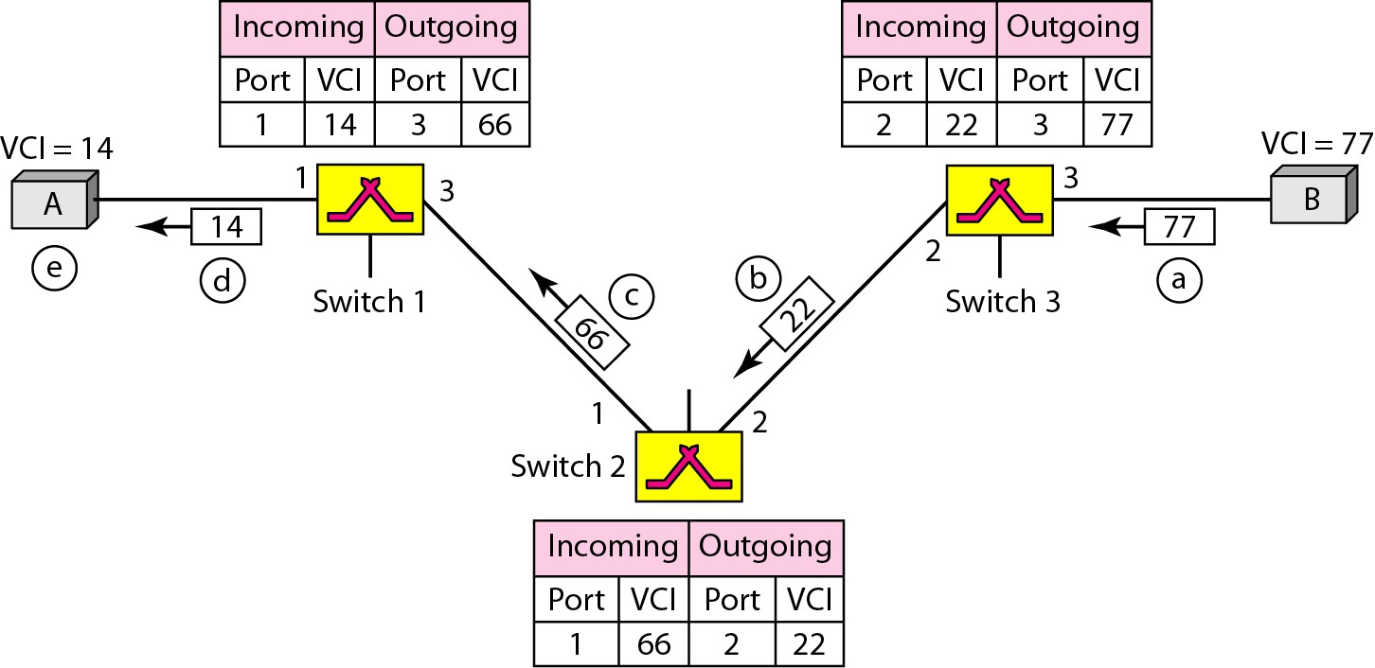
Virtual circuit switched networks

Slide 30
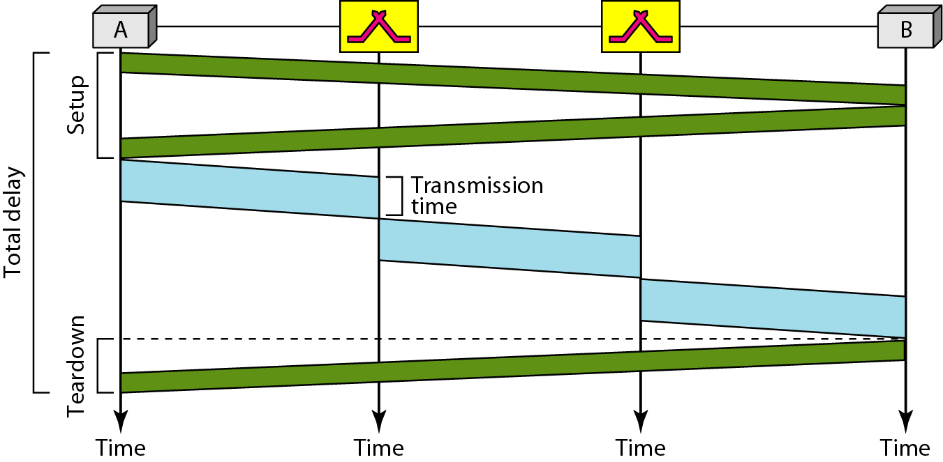
Delay in a virtual-circuit network

Slide 31
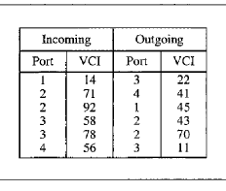
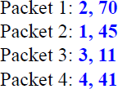
Virtual circuit switched networks
Eg:
  Find the output port and the output VCI for packet with the following input port and input VCI addresses:
    Packet 1: 3, 78
    Packet 2: 2, 92
    Packet 3: 4, 56
    Packet 4: 2, 71

Slide 32
Advantages of packet switching
Packet switching is cost effective
Packet switching offers improved delay
Packet can be rerouted if there is any problem, such as busy or disabled links
Many network users can share the same channel at the same time
Packet switching can maximize link efficiency by making optimal use of link bandwidth

Slide 33
Disadvantages of packet switching
Protocols for packet switching are typically more complex
If packet is lost, sender needs to retransmit the packet

Slide 34
Message Switching
With message switching there is no need to establish a dedicated
path between source and destination
When a station sends a message, the destination address is appended to the message
Each node receives the entire message, stores it on disk, and then transmits the message to the next node
This type of network is called a store-and-forward network
A time delay is introduced using this type of scheme due to store- and-forward time, plus the time required to find the next node in the transmission path

Slide 35
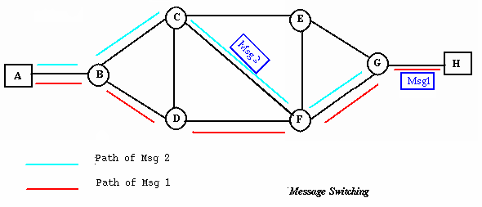
Message Switching

Slide 36
Multiplexing

Slide 37
Multiplexing
Whenever the bandwidth/time slot/rate of a medium linking two devices is greater than the needs of the devices, the link can be shared
Multiplexing is the set of techniques that allows the simultaneous
transmission of multiple signals across a single data link

Slide 38
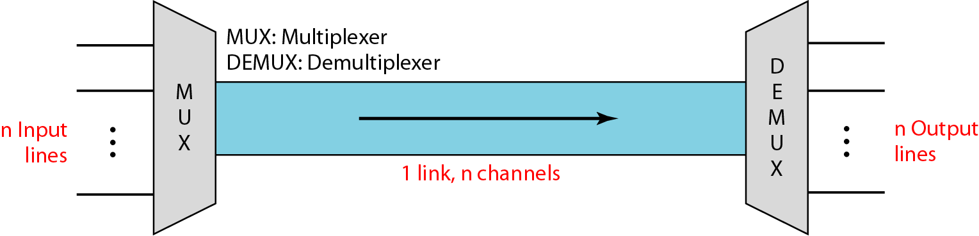
Multiplexing
A Multiplexer (MUX) is a device that combines several signals into a single signal
A Demultiplexer (DEMUX) is a device that performs the inverse operation

Slide 39
Advantages of Multiplexing
More than one signal can be sent over a single medium
The bandwidth of a medium can be utilized effectively

Slide 40
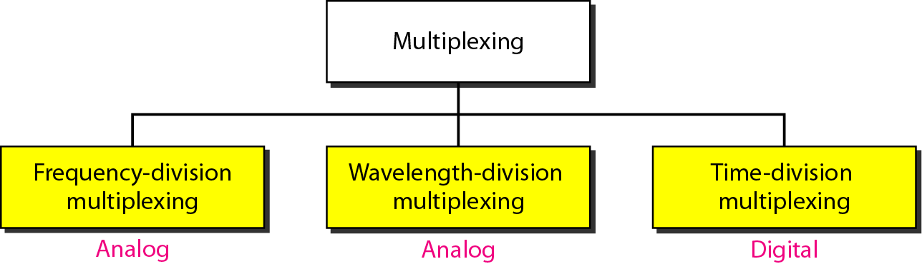
Categories of multiplexing

Slide 41
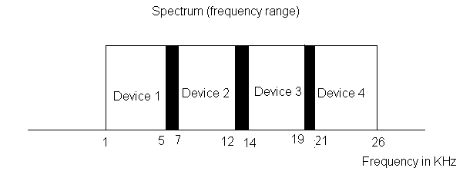
Frequency division multiplexing (FDM)
FDM is an analog technique that can be applied when the bandwidth of a link is greater than the combined bandwidths of the signals to be transmitted

Slide 42
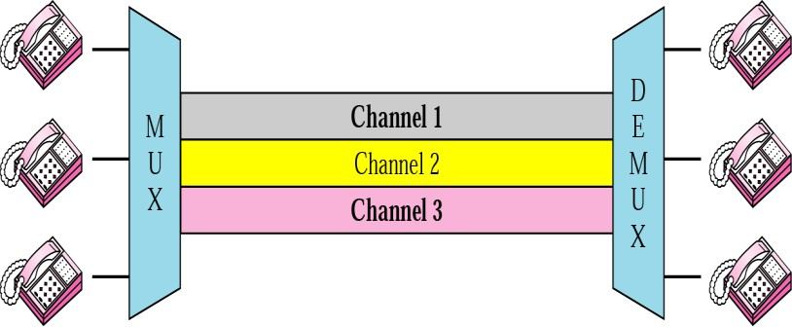
FDM
In FDM, signals generated by each device modulate different
carrier frequencies
These modulated signals are combined into a single composite signal that can be transported by the link

Slide 43
Applications of FDM
A very common application of FDM is FM radio broadcasting
Another common use of FDM is in television broadcasting

Slide 44
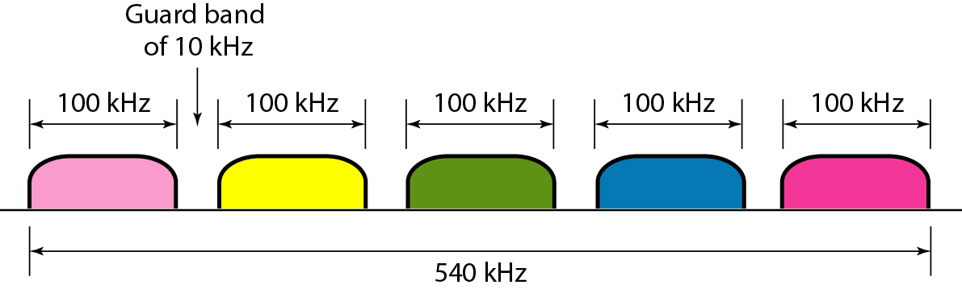
FDM
Eg:
– Five channels, each with a 100-kHz bandwidth, are to be multiplexed together. What is the minimum bandwidth of the link if there is a need for a guard band of 10 kHz between the channels to prevent interference?
Solution
For five channels, we need at least four guard bands. This means that the required bandwidth is at least
5 × 100 + 4 × 10 = 540 kHz

Slide 45
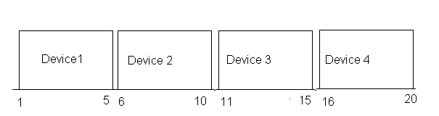
Time division multiplexing (TDM)
TDM is a digital process that can be applied when the data rate capacity of the transmission medium is greater than the data rate required by the sending and receiving devices

Slide 46
TDM

Slide 47
TDM
TDM can be implemented in two ways
  Synchronous TDM
    In synchronous TDM, every device has given the same time slot to transmit data
    Time slots are grouped into frames
  Asynchronous TDM
    asynchronous TDM also known as statistical division multiplexing
    time-slots are not fixed i.e. slots are flexible
    a device wants to send data is allotted with a time slot

Slide 48
Application of TDM
It used in ISDN (Integrated Services Digital Network) telephone
lines
It is used in PSTN (Public Switched Telephone Network)
It is used for some telephone system
Note: It can be used to multiplex both digital and analog signals but mainly used to multiplex digital signals

Slide 49
Wavelength Division Multiplexing (WDM)
Wavelength Division Multiplexing is same as FDM except that the optical signals (electromagnetic signal) are transmitted through the fiber optic cable
WDM is used on fiber optics to increase the capacity of a single
fiber
It is an analog multiplexing technique
At the receiving end, de-multiplexer separates the signals to transmit them to their respective destinations

Slide 50
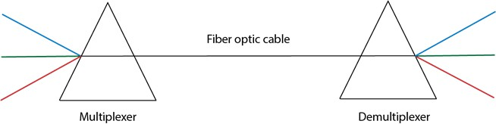
WDM
Prism can perform a role of multiplexer by combining the various optical signals to form a composite signal, and the composite signal is transmitted through a fibre optical cable
Prism also performs a reverse operation, i.e., demultiplexing the
signal

